Slide 1
A Dual Heterogeneous Graph Attention Network to Improve Long-Tail Performance for Shop Search in E-Commerce
ADVISOR: JIA-LING KOH
PRESENTER: CHENG-WEI CHEN
SOURCE: KDD’20
DATE: 2021/7/12

Slide 2
Outline
Introduction
Method
Experiment
Conclusion

Slide 3
Outline
Introduction
Search in E-commerce
What is Long-Tail
Target

Slide 4
Search in E-commerce
Query
Shop
Item

Slide 5
Search in E-commerce
Shop search

Slide 6
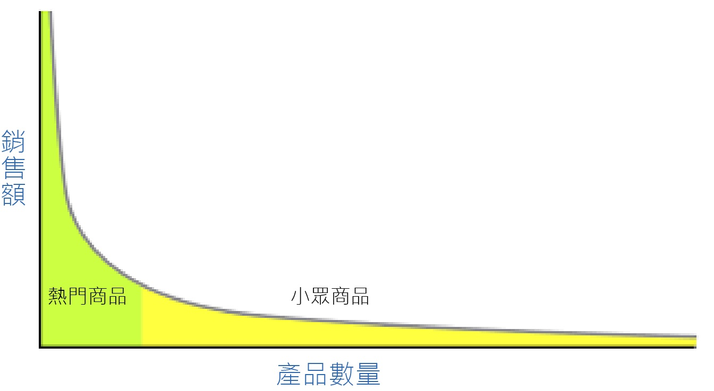
Long-Tail
Long-tail performance

Slide 7
Target
Many shop names do not fully express what they sell
Lack of user interactions, it is difficult to deliver a good search result for highly relevant to long-tail queries

Slide 8
Outline
Method
Architecture
Method detail
Loss function

Slide 9
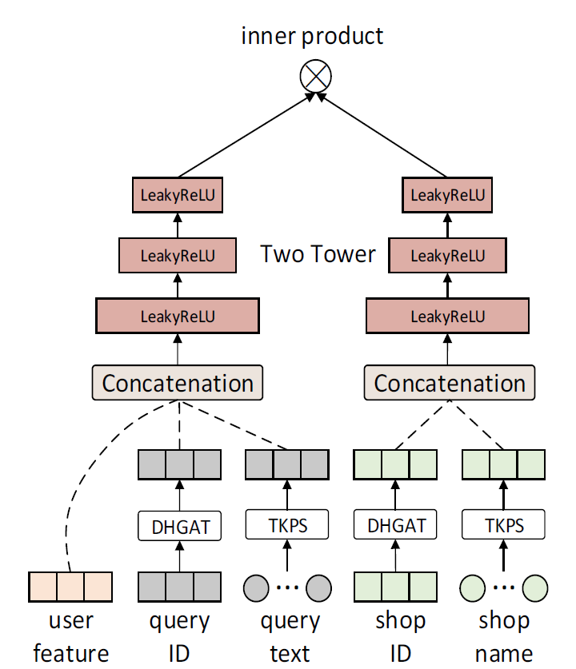
Architecture
Output:
Probability of user u
clicking shop s
after issuing query q
{
L layer of two-tower
Method in this paper
Input of user, shop, query

Slide 10
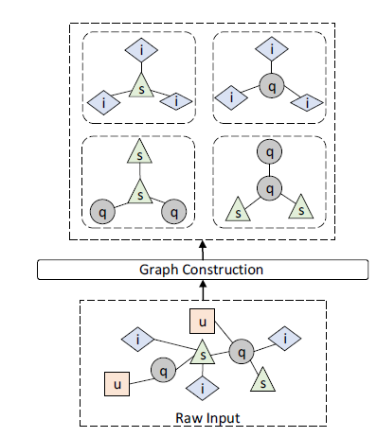
Neighbors
Product search based item neighbors
Nm(q),Nm(s)
Homogeneous and heterogeneous neighbors
No(q),No(s) Ne(q),Ne(s)
Search history for user

Slide 11
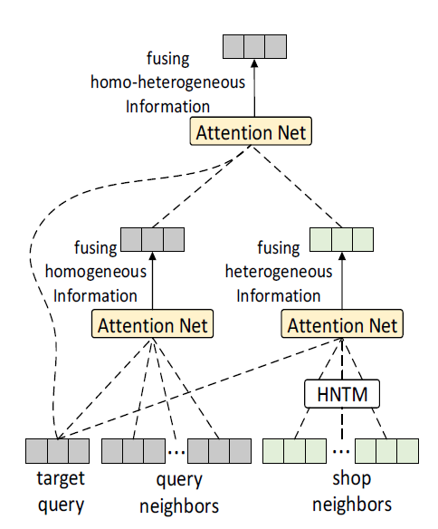
Method: DHGAT(Dual Heterogeneous Graph Attention Network)
Heterogeneous Neighbor Transformation Matrix

Slide 12
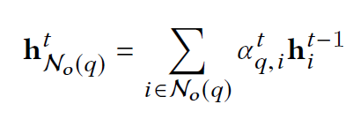
Method: DHGAT
P.S. hq 表示target query ID embedding
Attention parameter for layer t
Homogeneous neighbors
對目標Query 的重要程度
Concatenation
Query representation at layer t for homogeneous neighbors

Slide 13
Method: DHGAT
P.S. hq 表示target query ID embedding
Attention parameter for layer t
Heterogeneous neighbors
對目標Query 的重要程度
Concatenation
Query representation at layer t for heterogeneous neighbors
Transformation matrix between Query & shop

Slide 14
Method: DHGAT
Attention parameter for layer t
Heterogeneous neighbors 和
Homogeneous neighbors之間
的相對重要程度
Concatenation
Query representation for both heterogeneous and homogeneous neighbors
Transformation parameter
Query representation at layer t

Slide 15
Method: DHGAT
Heterogeneous Neighbor Transformation Matrix

Slide 16
Architecture
Output:
Probability of user u
clicking shop s
after issuing query q
{
L layer of two-tower
t
hs
Method in this paper
Input of user, shop, query

Slide 17
Neighbors
Product search based item neighbors
Nm(q),Nm(s)
Homogeneous and heterogeneous neighbors
No(q),No(s) Ne(q),Ne(s)
Search history for user

Slide 18
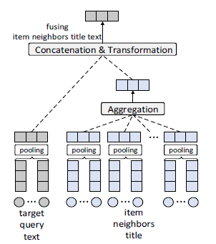
Method: TKPS (Transferring Knowledge from Product Search)
Terms embedding

Slide 19
Method: TKPS
Terms embedding
Lexicon W = { Wq,1, Wq,2, ......, Wq,n}
Lexicon W | Wq,1 | Wq,2 | Wq,3 | Wq,4 | …... | Wq,n
eq | 1 | 0 | 0 | 1 | 000000 | 0
ei | 1 | 0 | 1 | 1 | 000000 | 0
hand
Gucci
LV
bag
ARMANI
Query
Item
Example:
Query: hand bag
Item: LV hand bag

Slide 20
Method: TKPS
Lexicon W = { Wq,1, Wq,2, ......, Wq,n}
Mean pooling
low-dimensional dense vector representation
{ tq,1, tq,2, ...... , tq,n}
Query representation for item neighbor
eq = f (tq,1, tq,2, ...... , tq,n)
average function

Slide 21
Method: TKPS
eq
eNm(q1)
eNm(q2)
eNm(q3)
tq,1
tq,n
tq,1
tq,n
tq,1
tq,n
tq,1
tq,n
Wq,1
Wq,n
Wq,1
Wq,n
Wq,1
Wq,n
Wq,1
Wq,n

Slide 22
Architecture
Output:
Probability of user u
clicking shop s
after issuing query q
{
L layer of two-tower
t
hs
Method in this paper
Input of user, shop, query

Slide 23
User feature
multi-hot encoding form

Slide 24
Architecture
Output:
Probability of user u
clicking shop s
after issuing query q
fully-connected layer + sigmoid
{
L layer of two-tower
huq
es
t
hs
Method in this paper
Input of user, shop, query

Slide 25
Loss function
Ground-truth
Prediction
Current node
(Query or Shop)
Neighbors
(Homogenous)
Non-neighbors
(Homogenous)
L2-regularizer

Slide 26
Outline
Introduction
Method
Experiment
Conclusion

Slide 27
Dataset
Taobao dataset
Covers ten consecutive days of user’s click records from the shop search log of Taobao mobile App during November 2019
Serves over 120 million monthly active users

Slide 28
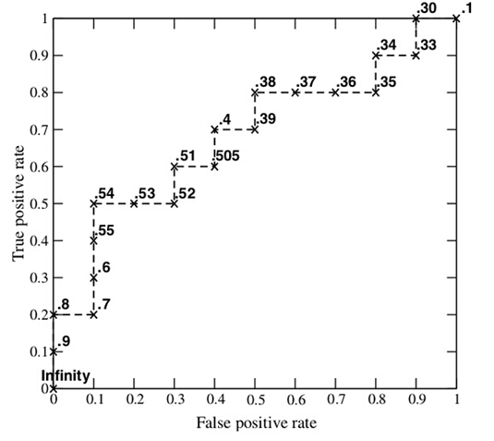
Experiment method
AUC: Area under ROC curve
MRR: Mean reciprocal rank
|Q|是查詢個數，ranki是第i個查詢
MRR = (1/3 + 1/2 + 1) /3 = 11/18

Slide 29
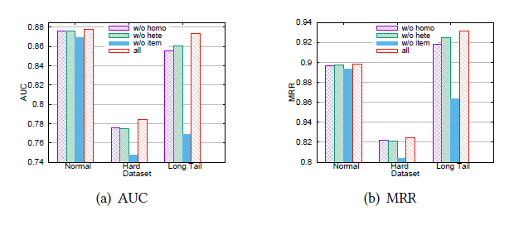
Result: Importance of neighbor
Differentiating the importance of neighbor types

Slide 30
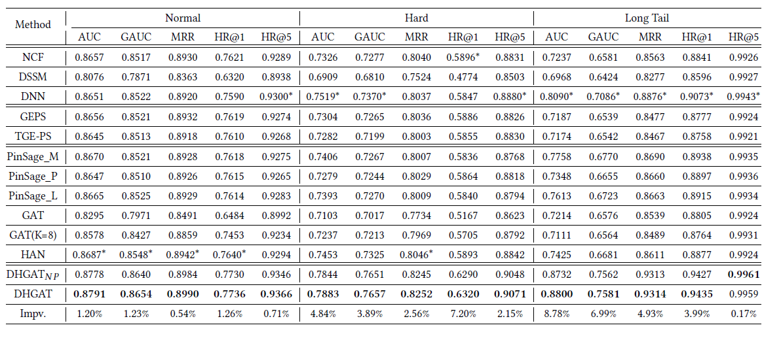
Result
Embedding
similarity
Graph
embedding
GNN
Neighbors
embedding
Hetrogenous
network

Slide 31
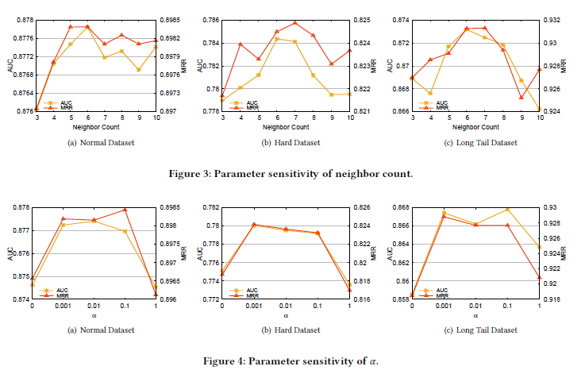
Result: different neighbors count and parameter α

Slide 32
Outline
Introduction
Method
Experiment
Conclusion

Slide 33
Conclusion
We propose a dual hierarchical graph attention network for e-commerce shop search task.
The proposed DHGAT selectively leverages heterogeneous and homogeneous relations of queries and shops simultaneously to derive the robust semantic representations for shop search, especially for long-tail performance enhancement.
We add a regularized neighbor proximity loss to main CTR prediction loss.

